Slide 1
Welcome to the world of full support.
TINA BALEK, ANDREJA HOČEVAR

Slide 2
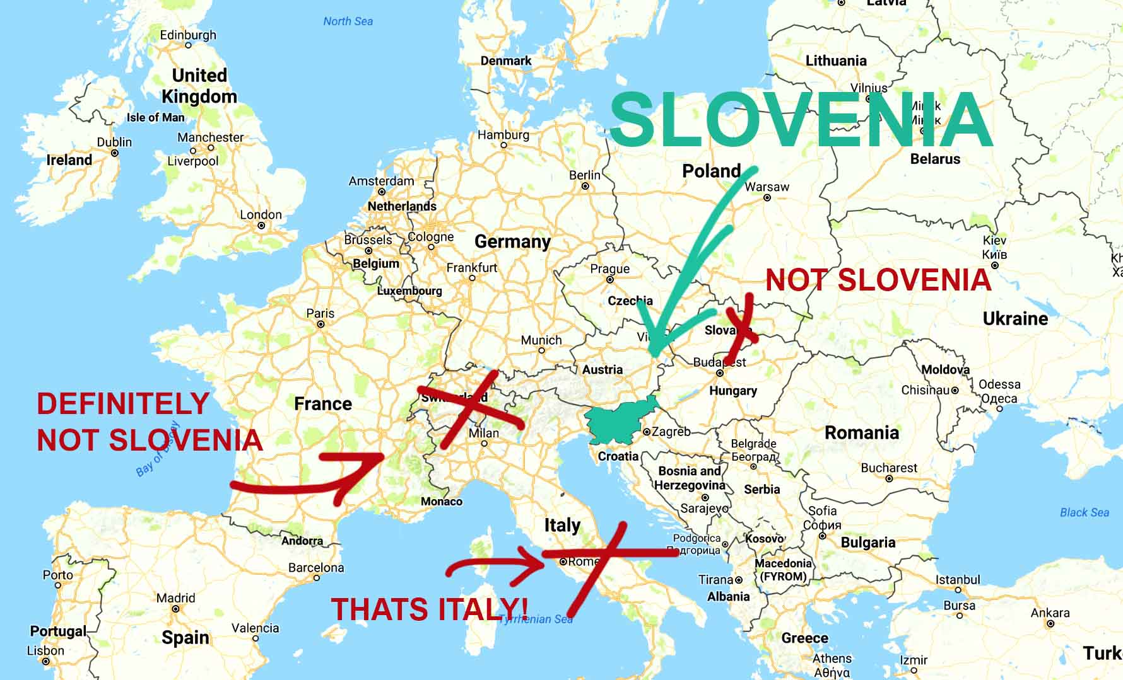
^{Slovenia}

Slide 3
^{Company} PROEVENT d.o.o.
History of the company - 1995
Full support to all clients from Slovenia or abroad
More than 40 experts
https://www.racunovodski-servis.si/en/
5 Departments:
Events and Fair Organization
Renting of equipment for Fairs
Technical department
Accounting Services
International department
More than 500 satisfied customers!

Slide 4
^{Our advantages}
Certified accounting services
Individual approach
Support in different programmes
Business optimisation
Accounting/Tax/Legal consulting

Slide 5
^{Our advantages}
Services for foreigners
Support in different languages: SLO, CRO, EN, GER, ITA, MAK,SRB, BIH
eVEM/SPOT point
Monitoring of changes in legislation in various areas and informing customers
Monitoring of Tenders and Grants
Excellent location in center of Ljubljana

Slide 6
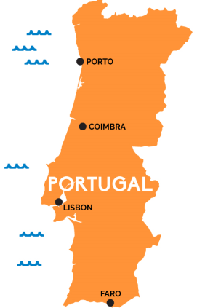
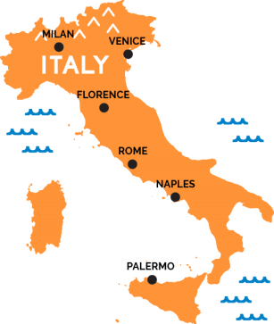
SERVICES FOR FOREIGNERS
Individual approach: Each company has own story
More than 100 foreign companies
Company registration (LTD/d.o.o.)
TAX/Legal/Accounting Advisory
Help with openning of bank accounts
Accounting Services
Virtuall Office
VAT number for Slovenia and other EU countries
Residence permit in Slovenia, Italy, Portugal

Slide 7
Company Registration in Slovenia
eVem/SPOT point
Establishment: 3-5 working days
Founding capital: 7500 EUR
Slovenian tax number for Shareholders and Directors
Slovenian Business register _ Ajpes
Bank account : Business, Personal

Slide 8
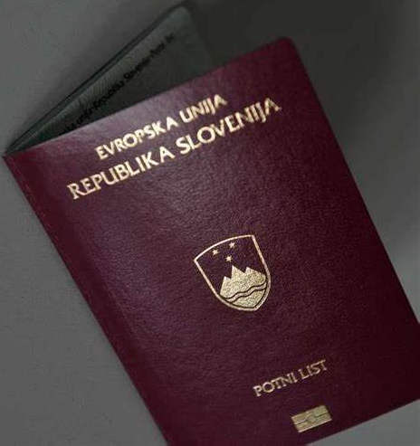
Single work and Residence permit in Slovenia
Employment in Slovenian Company
ACTIVE company:
Employee has at least University diploma / Bachellor degree
Employed person more than 6 months
Investment – 50.000 EUR (10 Employees)
Temporary Residence permit - TRP
Permanent Residence permit – after 5 years of TRP
Citizenship – after 10 years of TRP

Slide 9
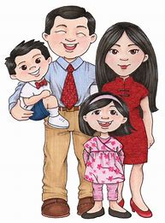
Family Reunification
Residence permit for Family members
Wife/husband, Children – 18 years
After 1 RP Prolongation
Min. 385 EUR/month/Family member

Slide 10
BLUE CARD
RP for people with high level od eduction
University diploma/Master degree/Doctoral studies
Easier access to Europe countries
Blue Card → Family Reunification
Higher salary: min. 1500 EUR gross per month
Validity: 5 years

Slide 11
Student Visa
Residence permit based on study
Public or Private Faculties
Primary school
Secondary School
University programme
Tuitions
Programmes for 2, 3 or 5 years
Lectures in Slovenian or English language

Slide 12
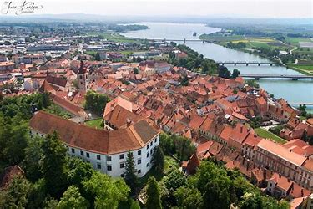
Life in Slovenia
Search for appartments
Enrolment in schools
Language Schools
Car rental
Driving licence
Health Insurance

Slide 13
Welcome to the world of full support.
^{Welcome to Slovenia.}

