Slide 1
Your next investment destination

Slide 2
Table of contents
01
CMS your partner for investment in Slovenia
02
How to form a Ltd in Slovenia?
03
Purchase of real estate in Slovenia
04
Overlook of the Slovenian workforce market regulation

Slide 3
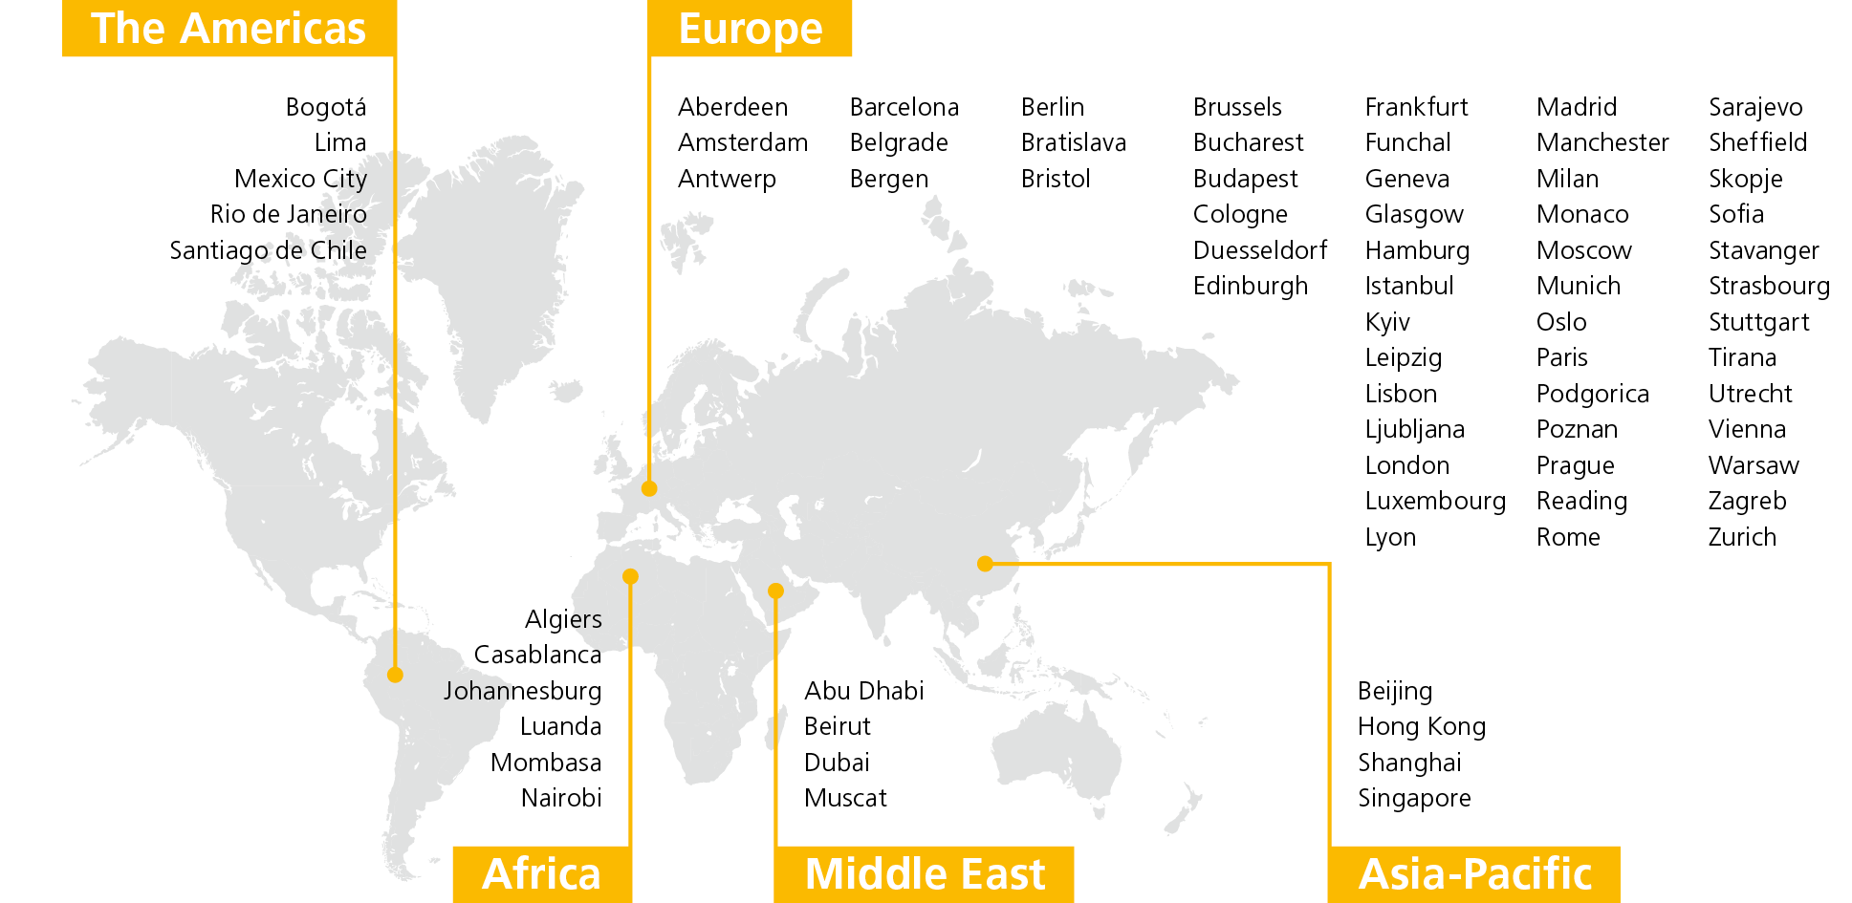
CMS, Global Legal Network
Slovenia – Turkey Business Club | September 2021

Slide 4
Staff
Lawyers
Partners
19 PRACTICE AND SECTOR GROUPS WORKING ACROSS OFFICES
> 8,000
> 5,000
> 1,100
Operating in
Across
73
44
EUR 1.475bn
countries
cities
turnover for 2020
52 NEW PARTNERS IN 2020, TAKING THE TOTAL TO OVER 1,100
# 1 CEE, DACH, Germany (Mergermarket)
Top rankings in Bloomberg, Mergermarket and Thomson Reuters
(by deal count)
#1 in Germany, DACH and Austria
#2 in Europe, UK, Switzerland and Benelux
# 1 Germany, UK (Thomson Reuters)
# 1 Europe, Germany, UK (Bloomberg)
Slovenia – Turkey Business Club | September 2021

Slide 5
Why CMS is perfect partner for your next investment?
One-stop-shop support for smooth running of very complex business projects.
International experience with big-scale as well as small-scale investments in 44 jurisdictions across the world.
CMS has its office also in Turkey, which means that there will always be someone who speaks your language at your hand.
We have proven our ability to blend international legal advice with the in-depth local knowledge which is a definate added value in cross-border projects.
You can rest assured that the advice we provide is pragmatic and solution-oriented.
In addition to legal advisory, we also cover tax aspects to investment projects.
Our Client come from different industry sectors: Automotive, Pharma, Chemical, IT, Energy, Transport & Logistics, Retail, Construction, Food & Beverage, Financial and Insurance industry…

Slide 6
How to form a LLC in Slovenia?
Short overview of procedures and documents

Slide 7
How to form a LLC in Slovenia?
The most frequent form of business incorporation is limited liability company (In Slovene “družba z omejeno odgovornostjo”) or shortly a Llc (in Slovene d.o.o.”). Other forms of incorporation under the provisions of the Slovenian Companies Act (Zakon o gospodarskih družbah; "ZGD-1") are joint-stock company (“d.d.”), unlimited company (“d.n.o.”), limited partnership (“k.d.”), sole propriotor (“s.p.”) or a branch of a foreign company (“podružnica”).
We have outlined below the main features of the Llc:
1 | Number of shareholders
One shareholder or more (up to 50) can establish a Llc.
2 | Initial share capital
Shareholders need to ensure the initial capital when establishing the company in the minimum amount of EUR 7,500 paid in either as cash or in-kind contribution (minimum contribution at least EUR 50).
3 | Directors/proxies
Llc can have one or more directors, appointed for definite or indefinite time, that run operations and represent the company, individually or jointly, on its own responsibility.
Proxy (procura holder) can be appointed, who is authorized for all legal acts in the name of the company, except for disposal and encumbrance of real estate.
4 | Transfer of business share
Business share can be transferred to a third party and other shareholders have a pre-emptive right, unless articles of association provide otherwise. Articles of association can also define other requirement and conditions in connection with such transfer of shares.
5 | Shareholders’ rights/Shareholders’ meeting
Shareholders have a right to:
profit distribution, proportionate to their business share (articles of association can define different percentages); vote, which they exercise in shareholder’s meeting (Generally, a shareholder has one vote per each EUR 50 contribution and shareholders decide with majority of votes at the shareholder’s meeting (the law and the shareholder’s agreement can define a different majority, e.g. ¾ majority for the change of the AoA).
6 | Supervisory board
Llc can have a supervisory board, but it is not required.

Slide 8
How to form a LLC in Slovenia?
7 | Simple Llc. / Complex Ltd.
Simple Llc. If the single shareholder pays all the contributions in cash, accepts the articles of association in a standard form (limited possibility to regulate differently company structure) and keeps an electronic register of resolutions, ya Llc. can be established directly through the online portal SPOT (Slovenian Business Point), at the SPOT point or at notary office. The establishment is free of charge. Complex Ltd. If the above conditions are not met, Ltd. will have to be set-up at a notary office. Notary will charge for his services according to the notary tariff.
2 | Supplementing documents
Certified statement of persons to be appointed as directors/proxies that there are no restrictions for their appointment and that they consent to their appointment. Adopted resolution of the management on business address and e-mail address. Notarised statement of the building owner, where the business address is.
3 | Acquiring the Slovenian tax number for non-Slovenian founders and new directors and proxies.
 | non-Slovenian founders and new directors and proxies.
Copy of personal identification document for a natural person. Original excerpt from the court register for a (legal entity) with a certified translation in the Slovenian language.
Court register excerpt for the founders with certified translation in the Slovenian language. Certificate from the competent foreign tax authority that the founder has no outstanding tax liabilities (not older than 30 days). Extract from the competent foreign office for criminal records and misdemeanors records (not older than 30 days) . Statement of founders that they do not have any unsettled obligations to the state from previous business operations. Resolutions on appointment of directors/proxies.
The overview of the relevant documentation for establishing a LLC:
1 | Articles of association
Signed in form of a notarial deed by founders at a notary public or with only a notarised signature (one founder).

Slide 9
5 | Opening of a temporary bank account for transferring the money for the purposes of initial share capital and the obtainment of the bank’s confirmation on the paid in capital.
Signed articles of association. Adopted resolution on business address and e-mail address. Adopted resolutions on appointment of directors/proxies. Identification documents and tax number for directors/proxies and founders. Notarized PoA for the authorized person arranging the opening of the account (present in person). KYC procedure - Ultimate beneficial owner documentation for each funder (notarised extracts from the business/court register, showing the ownership chain).
7 | “post-incorporation” actions
Notification of the ultimate beneficial owner (UBO -25% + 1 share) to the commercial/court register (Certified court register excerpt showing the complete chain of ownership from UBO in relation to the company in Slovenia and Copy of personal identification document/court register extract for UBO will be needed). Opening of a regular bank account. Extract of the newly established company. Personal identification of the signatories of the company by the bank. Contract with the bank.

Slide 10
Purchase of real estate in Slovenia

Slide 11
Purchase of real estate in Slovenia
Citizens of EU, EEC and/or OECD member states (among which is also Turkey) as well as legal entities with a seat in any of these countries can acquire real estate in Slovenia under the same conditions as citizens of the Republic of Slovenia (all other can acquiree real estate only under the condition of reciprocity).
A foreign legal entity that does not have a registered office or other form of registration in Slovenia must:
register with the tax office before purchasing the property. At the same time, the responsible person of the foreign company must also register in the tax register. In connection with the tax number, the owner of the real estate will also become liable for the taxes relating to the real estate (which include, for example, the NUSZ).
In order to register the ownership right in the Land Register, the foreign company also needs a unique identification number, which is obtained by registering with Court register/Ajpes upon written request of the applicant.
The (foreign) investors usually choose to set up a local company or branch in Slovenia or acquire already established legal entity for the acquisition of real estate (as an asset deal).
Acquisition of ownership of real estate is possible on the basis of a binding agreement and registration in the Land register.
All agreements for the transfer of real estate have to be executed in writing and concluded according to the Slovenian law.
In order to register the ownership of real estate in the Land Register the seller's signature on the land registry permission either included in the agreement or attached to it as a separate document needs to be notarized
Ownership title is transferred to the buyer upon its registration in the Land Register
.
The purchase price is freely negotiable. In addition, the price may be agreed in a foreign currency, but the purchase price should be paid in EUR

Slide 12
Purchase of real estate in Slovenia
The Land Register is a public register used to record and make public information about rights and legal facts relating to immovable property, which is since 2009 electronically available under the link: http://evlozisce.sodisce.si/esodstvo.
The Land Register records all rights in rem in immovable property (e.g. ownership, mortgage, land debt, easement, encumbrance, building right) and some contractual rights (e.g. lease rights, pre-emption, if created by a legal transaction, a special right of use of a public good and under some further statutory limitations the right to prohibit alienation or encumbrance).
The underlying documentation for registration of the ownership right in the Land Register are:
different types of contracts (simple written form / a notarial deed),
a final court decision, including a final decision on inheritance, a final decision in a foreclosure proceeding on immovable property in a bankruptcy proceeding, other final or definitive decisions of a court or other public authority.
The principle of trust in the Land Register data as the public ledger applies:
Anyone who acts honestly in legal transactions and relies on the information on rights entered in the Land Register shall not suffer adverse consequences as a result. Whoever fulfils the conditions for the entry of a right or a legal fact in the Land Register in his favour and does not request such entry shall bear all the adverse consequences of such omission.
Entry of rights and legal facts in the Land Register shall take effect from the moment when the Land Registry Court has received the proposal for entry or when the Land Registry Court has received the document on the basis of which it decides on the entry ex officio.
All entries in the Land Register shall be public. The publicity of the electronic Land Register is also ensured through the online availability of Land Register information.

Slide 13
Slovenian workforce market regulation

Slide 14
Slovenian workforce market regulation
2 | No consent to the joint permit needed
for self-employed foreigners, if they become self-employed after one year of continuous legal residence in Slovenia or if the employee is entered in the business register as a person who will carry out an independent professional activity. sports coaches, professional athletes or private sports workers, foreign correspondents or reporters for foreign media, foreigners promoting the interests of Slovenia in the fields of economy, education, science and culture, to exercise the priestly profession or religious activity within a registered religious community, to organize or conduct charitable and humanitarian activities within a recognized humanitarian organization or a registered religious community.
3 | Free access to labour market
Free movement of persons is one of the fundamental freedoms of the EU internal market, alongside the free movement of goods, capital and services. The right to free movement within the EU applies to workers, students, pensioners - in short, to all EU citizens and their family members (regardless of nationality). Third party foreigners (inter alia): residing in Slovenia on the basis of a temporary residence permit for the purpose of family reunification with a Slovenian citizen; residing in Slovenia on the basis of a permanent residence permit; residing in Slovenia on the basis of a temporary residence permit as a victim of trafficking in human beings or as a victim of illegal employment; who have been granted the right to international protection in Slovenia and family members who are residing in Slovenia
1 | Joint (residence and working) permit
It allows a foreigner to enter, reside and work in the Republic of Slovenia. The application is submitted to the administrative unit or diplomatic consular representation in the country of employee’s origin. The Employment Service of Slovenia, at the request of the administrative unit, gives its consent to the joint permit (within 15 days), if both the employer and the employee meet certain conditions in order to obtain the single permit. The conditions for the consent to a joint permit depend on the purpose of the issue: employment, self-employment, extension of employment, change of jobs with the same employer, change of the employers or the work for two or more employers, EU Blue Card, posted workers, training and educational purposes, individual services provided by foreigners, Work of directors for more than 90 days in any calendar year, or seasonal agricultural work for more than 90 days.

Slide 15
Slovenian workforce market regulation
Seconded employees
The Employment Service of Slovenia issues a consent for the seconded workers, if the seconded employee has been employed with the employer
for at least nine months continuously;
for a continuous period of six months, and if:
the seconded worker has been appointed within capital-related companies,
has at least a university degree and
is being seconded for the purpose of professional development or training in business techniques or method.
Employment
The Employment Service of Slovenia issues a consent to the work permit for the employment in Slovenia, if (among others) following conditions are met:
there is no other eligible job candidate on the unemployment register for the same job;
The employer is duly registered to carry out the activity in which the foreigner will work;
The employer is not in liquidation or bankruptcy proceedings;
The employer has paid all tax obligations
The employer employs at least one person on full-time basis and pays compulsory social security contributions at least six months before the application is submitted; or
the employer had, in each of the six months preceding the application, at least EUR 10 000 income from the business activity on a bank account opened in Slovenia;.
If the employer has been registered for less than 6 months and wants to employ a foreign worker, the employer must provide proof of investment of at least EUR 50,000 in the activity where the foreigner will work before applying for the single permit.

Slide 16
Slovenian workforce market regulation
Consent to work as an authorized representative of a Slovenian legal entity
The Employer employs at least one person on full-time basis and paid compulsory social contributions in the period of at least six months before the application is submitted;
The employer had, in each of the six months preceding the application, an inflow of at least EUR 10 000 from the activity into a bank account opened in Slovenia;
The Employer has no outstanding tax obligations;
Entry info the court/ business register;
An employment contract or a civil law contract on management activity has been signed
the annual quota of consents to the single permit, which may be set by the Slovenian government to limit the number of foreigners on the labour market, has not yet been used.
Consent to the EU Blue Card
A Blue Card is a temporary residence permit for highly-skilled employees.
A consent to EU Blue Card will be issued, if the (inter alia) following conditions are met:
the foreigner has at least a higher education qualification;
an employment contract for at least one year, guaranteeing a salary of 1.5 times the average gross annual salary in Slovenia (average monthly gross salary 1,940.69 EUR);
there is no other eligible worker on the labour market;
The employer is duly registered for the activity in which the foreigner will work;
The employer is not in bankruptcy or liquidation proceedings;
has paid all tax obligations.

Slide 17
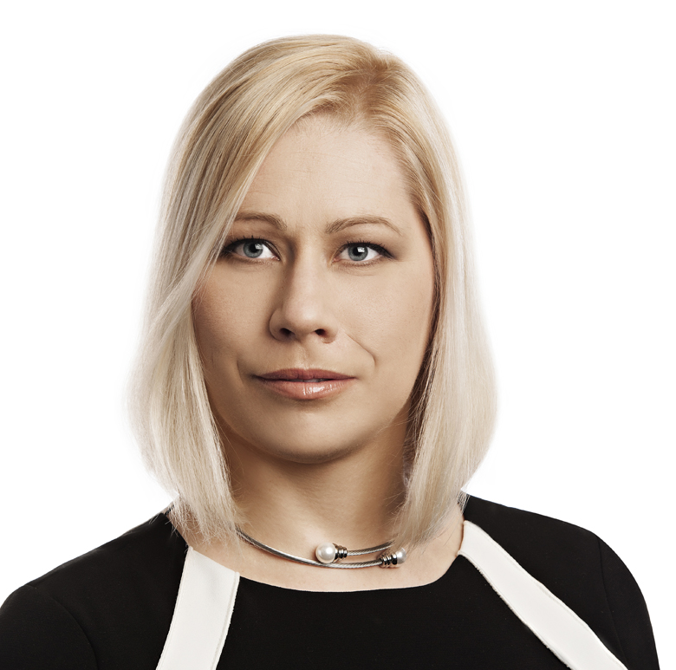
Your CMS contact in Slovenia
Dunja Jandl
Partner, Attorney at law
CMS Ljubljana
Real Estate, Energy. Hotel & Leisure
T +386 1 620 5210
E dunja.jandl@cms-rrh.com
Expertise
Dunja Jandl is a partner with CMS Slovenia and is heading the Real Estate & Construction and Energy, Public Procurement and Litigation departments of CMS Slovenia. She has over 15 years of work experience and has held senior positions in international law firms for the past six years.
She heads on regular basis large-scale real estate development and transaction projects focusing on commercial and hotel & leisure properties. Her vast expertise in construction, regulatory, environmental, financing and dispute resolution aspects of such projects offers her clients indispensable support in the implementation of complex projects in Slovenia. Her additional focus are infrastructure and energy projects. Dunja has been in the recent years the lead adviser on
several large real estate development and transaction projects in Slovenia.
Languages
Slovenian, English, German
Education
Dunja obtained her LL.M.Eur degree from LMU Munich in 2006 and is a certified mediator.
Rankings & Quoutes
Dunja Jandl „is always reliable and understands our needs.“
(Chambers & Partners, Real Estate, 2021)

