Slide 1
Zdenka Pečnik Kočevar, CEO & Founder
OGRAJE KOČEVAR d.o.o.
Tovarniška cesta 11 c, 3312 Prebold Slovenia - EU
zdenka@ograje.com
M: +386 (0)41 754 865
www.ograje.com

Slide 2
Janez Kočevar
OGRAJE KOČEVAR d.o.o.
Tovarniška cesta 11 c,
3312 Prebold
Slovenia
Janez.Kocevar@ograje.com
+386 41 588 022
www.ograje.com

Slide 3
Vision
Complete fencing solutions focusing on demanding customers and projects
CE market leader
Measure and design
Designing, engineering
Custom-made solutions
Assembly

Slide 4
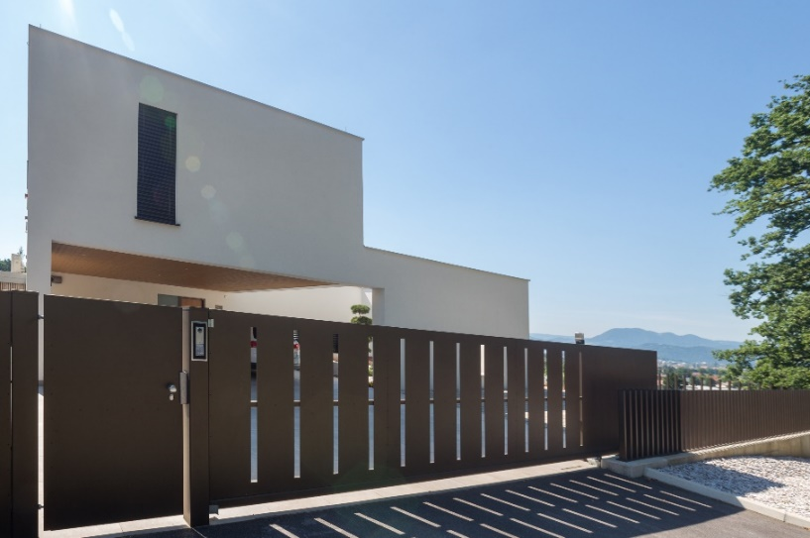
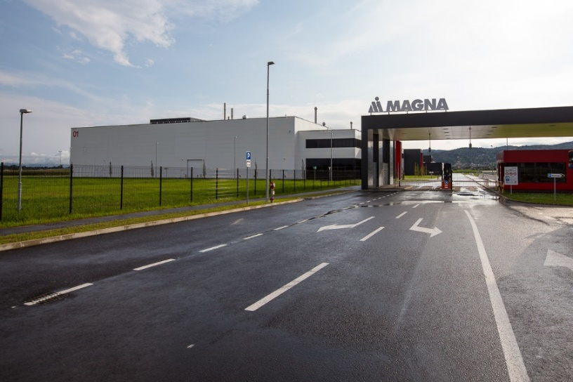
THE BEST EXECUTION OF SAFETY AND DESIGN
We provide complete fencing system solutions
We are the biggest producer and supplier of fencing systems in Slovenia
Our solutions:
combine security with aesthetic completeness
function as visual and noise barriers for residential and commercial premises
Require almost no maintenance
Long-life and durability

Slide 5
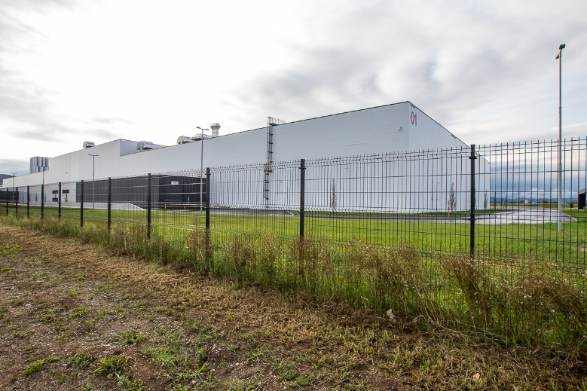
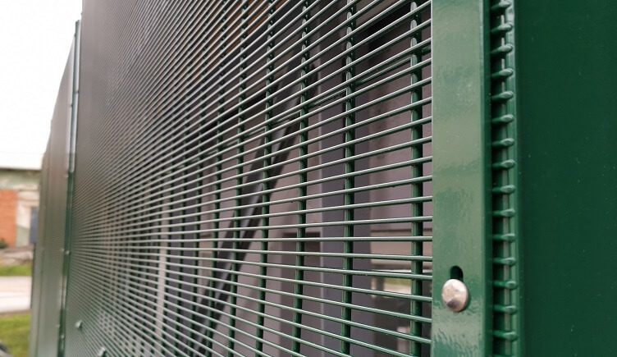
THE BEST EXECUTION OF SAFETY AND DESIGN
We provide complete turnkey solutions, from planning, manufacturing and installation
Annually we produce over 6.000 complete fencing systems and install over 180 km of fencing
Everything is done in-house and is the result of our own R&D, know-how and expertise

Slide 6
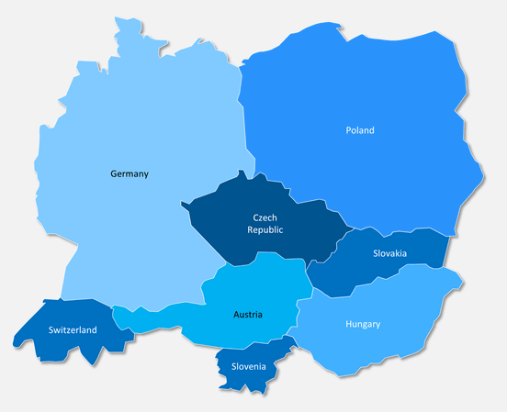
FACTS ABOUT US
Positioned in Central Europe
A family-owned company with 15 years of experience in the field of manufacturing fences and fence gates
80 employees
> 60.000 projects, > 2.000 km of fences built

Slide 7
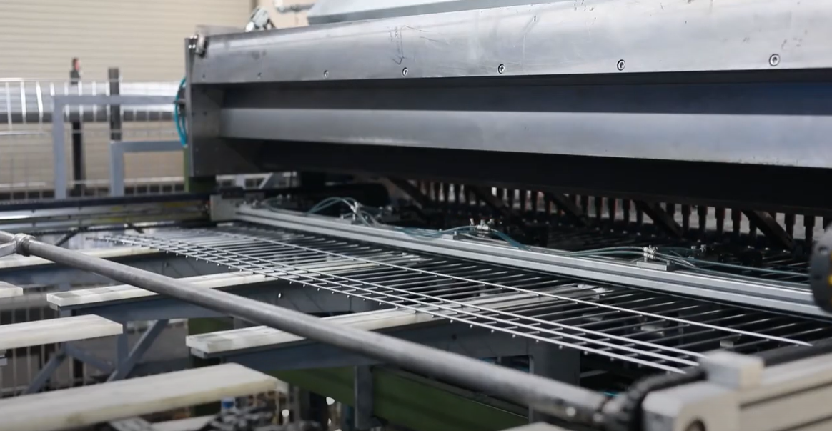
FACTS ABOUT US
Developed from a company with a 35-year tradition of manufacturing welding machines
We are expanding from Slovenia into other EU markets (Austria, Italy, Croatia...)
Dynamic growth - on an annual basis exceeds 15%

Slide 8
OUR STRENGHTS
Fencing Specialists
Market leader in Slovenia
We provide solutions from the first contact with the customer through technological design, drawing, manufacturing, installation/assembly and after-sales service
Use the highest quality materials and components
In House Research & Development

Slide 9
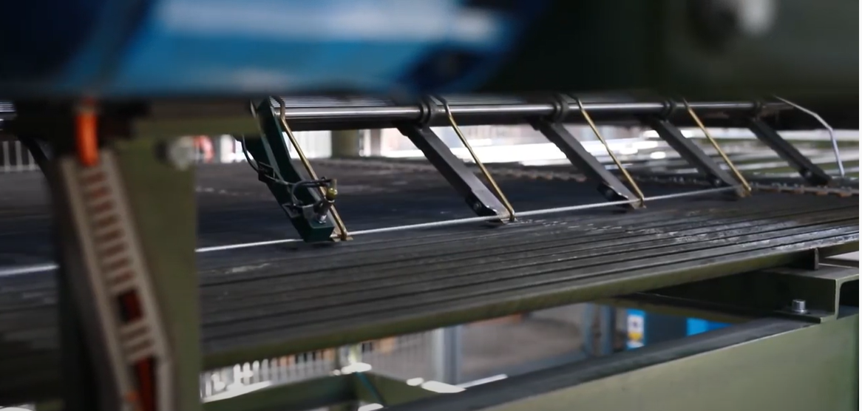
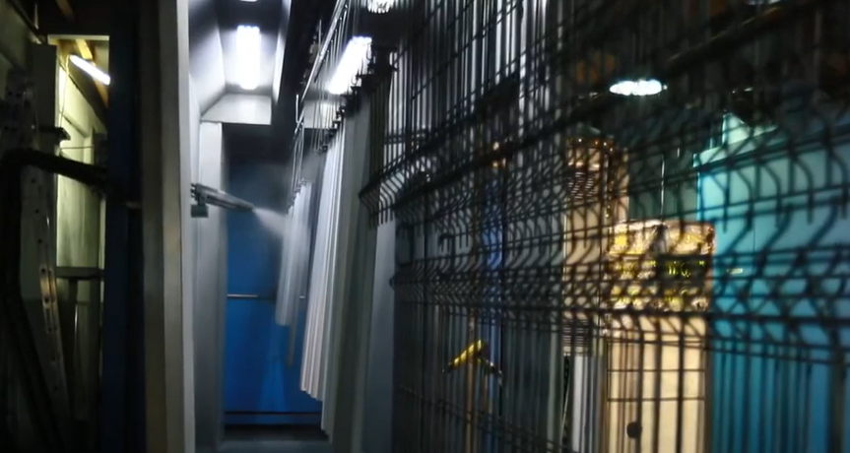
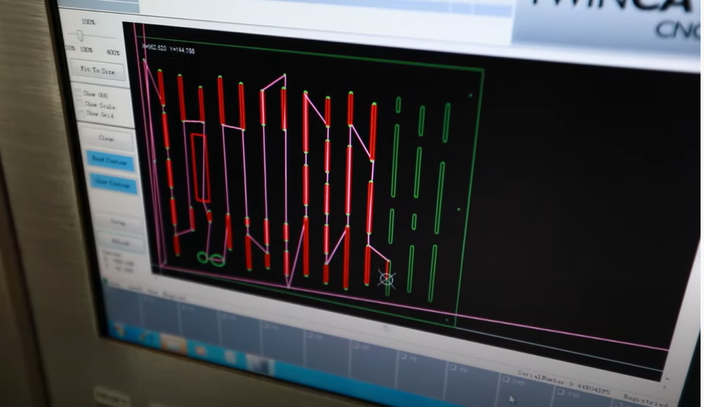
OUR TECHNOLOGY
Engineering, design and visualization
Wire mesh welding
Steel construction welding
Powder coating
Installation

Slide 10
WHY CHOOSE US?
Over 15 years experience in manufacturing fences, railings, balconies and gates of an outstanding design and top quality,
Our product portfolio is the result of our own expertise and development.
We provide a comprehensive service, from planning to execution – installation and assembly.
Thousands of satisfied customers place their trust in our products every year – we make it our concern that your home and living space is truly your world, your pride, your intimate space and safe haven.

Slide 11
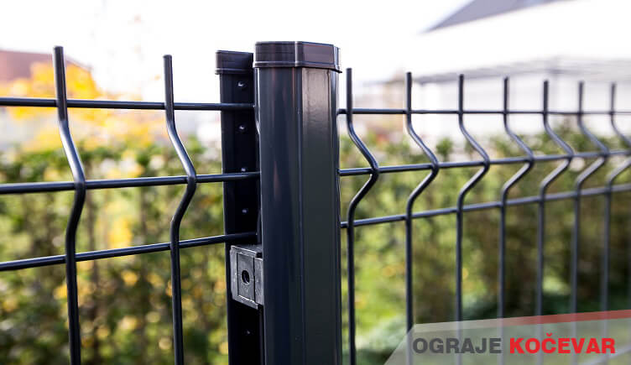
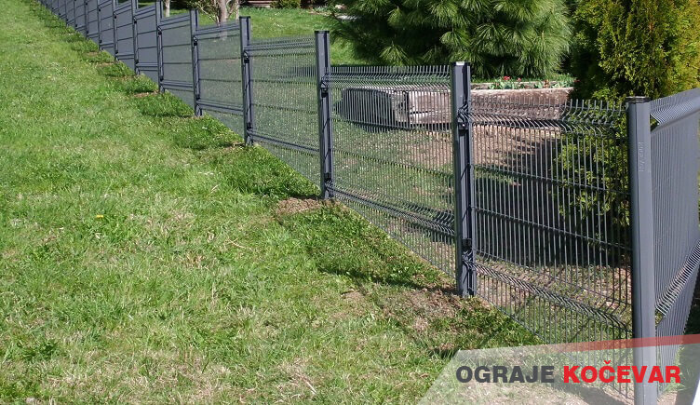
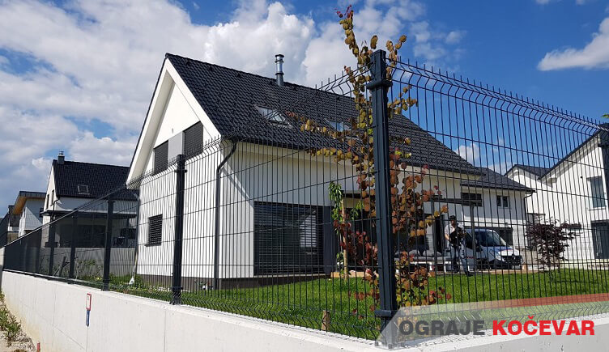
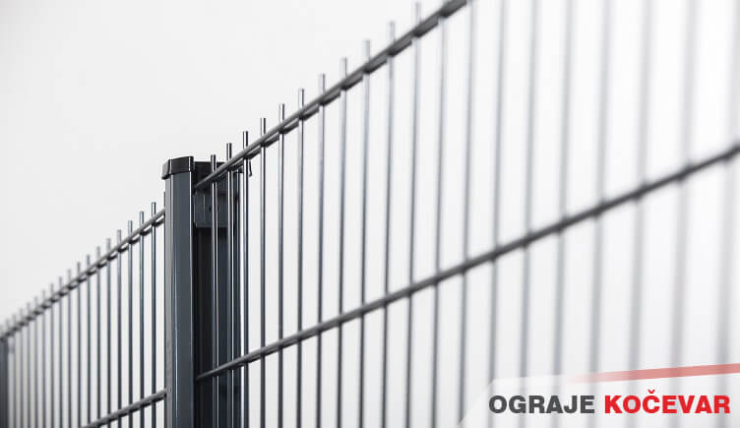
PORTFOLIO – 3D, 2D PANELS

Slide 12
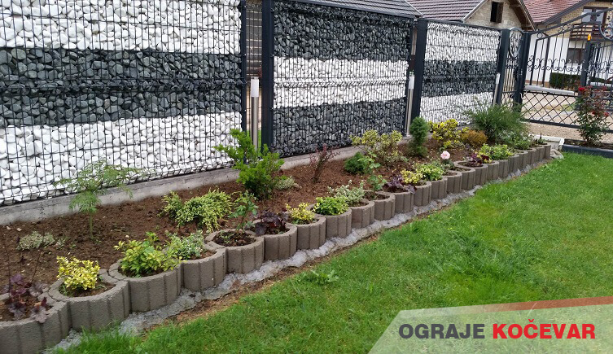
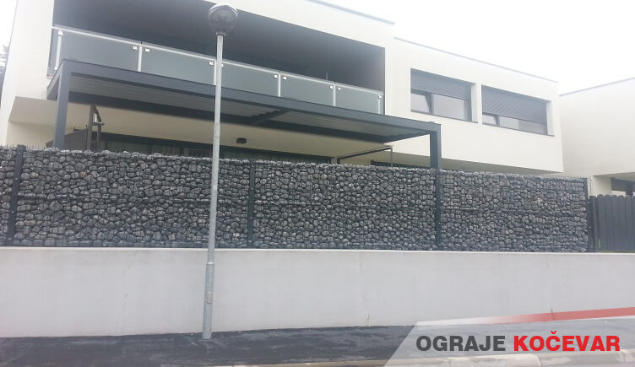
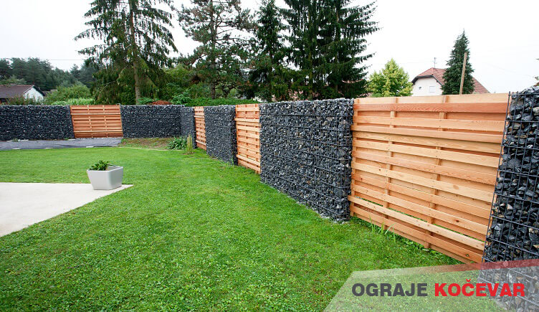
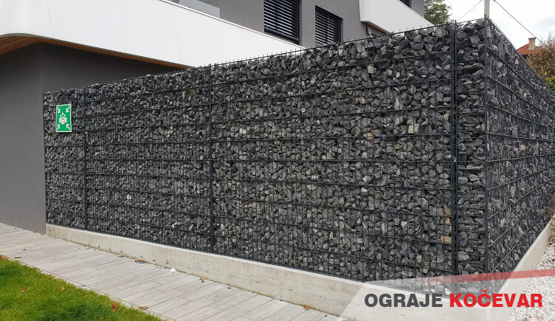
PORTFOLIO – STONE/GABION FENCING

Slide 13
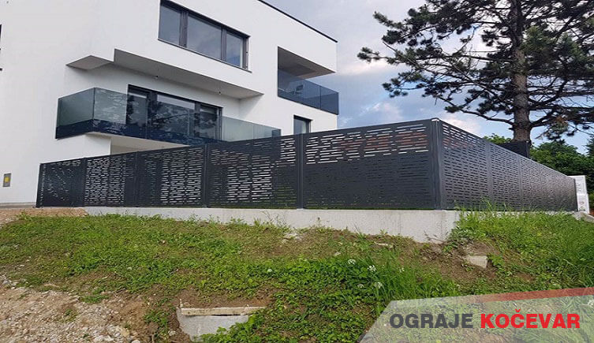
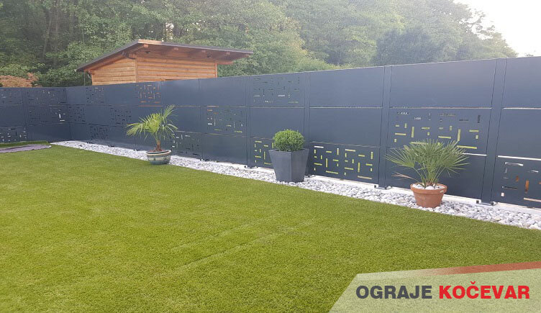
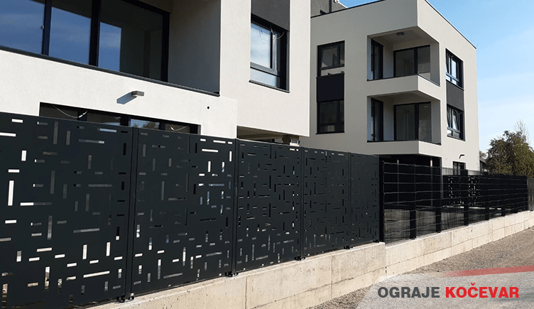
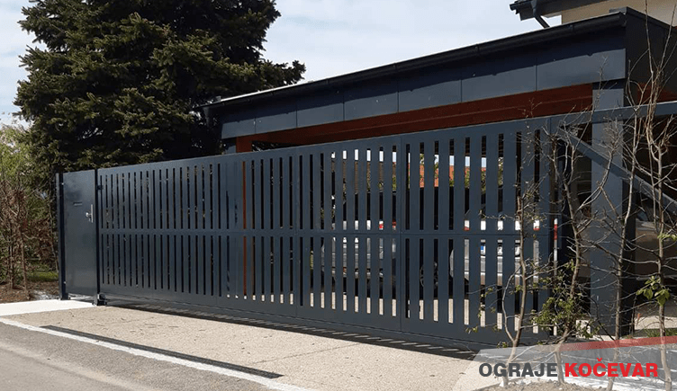
PORTFOLIO – PERFORATED SHEET FENCES

Slide 14
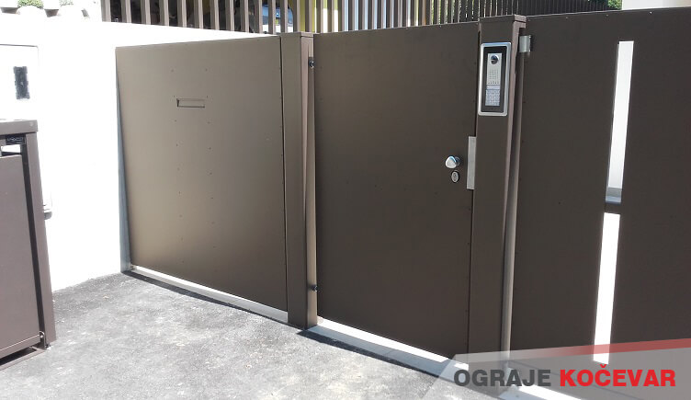
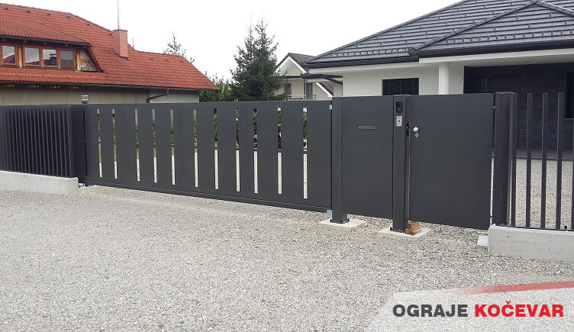
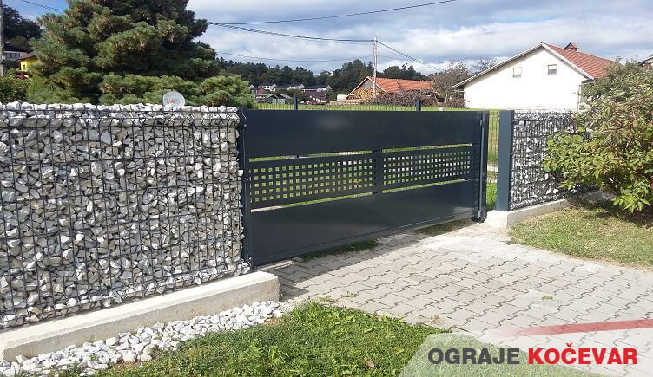
PORTFOLIO – GATES

Slide 15
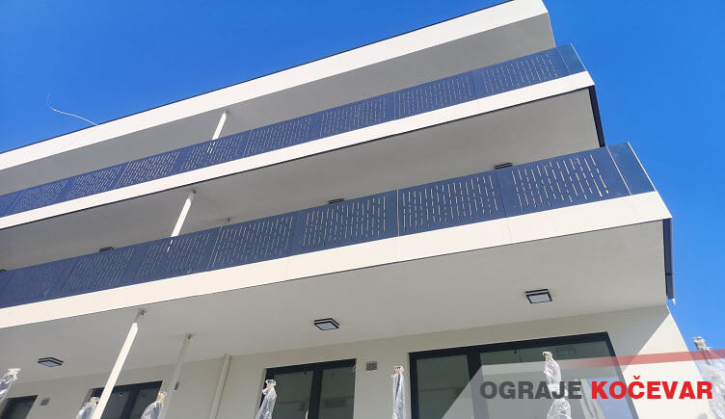
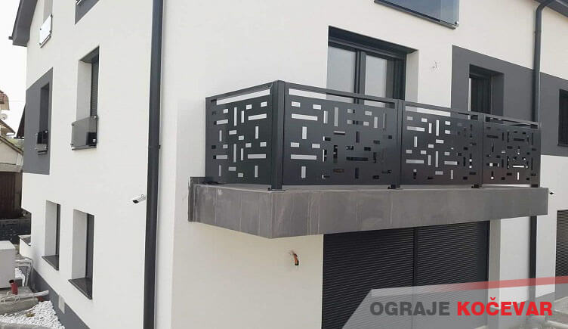
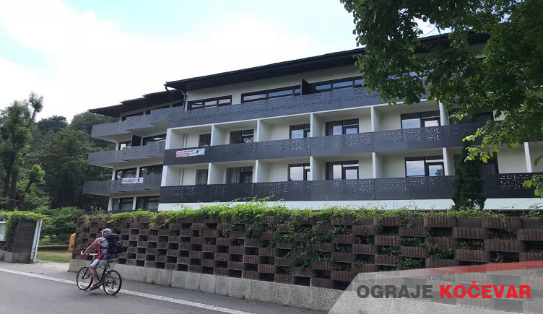
PORTFOLIO – BALCONIES, RAILINGS

Slide 16
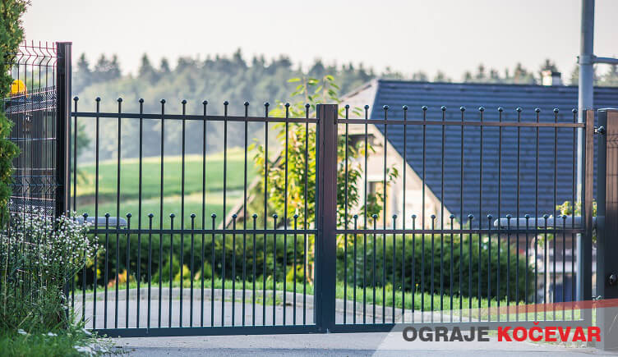
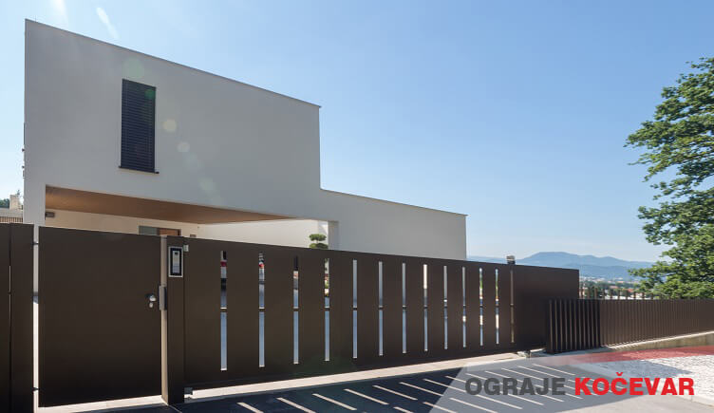
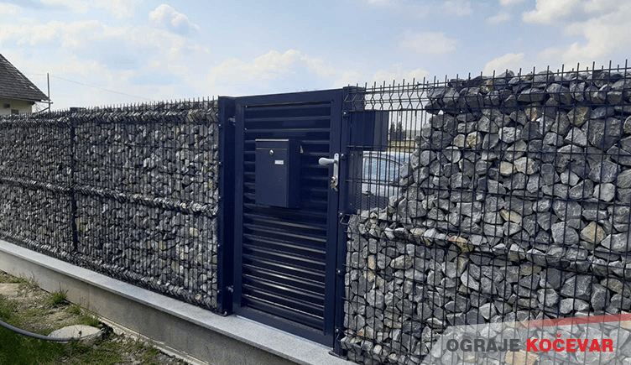
REFERENCES – RESIDENTIAL PROJECTS

Slide 17
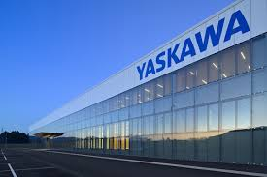
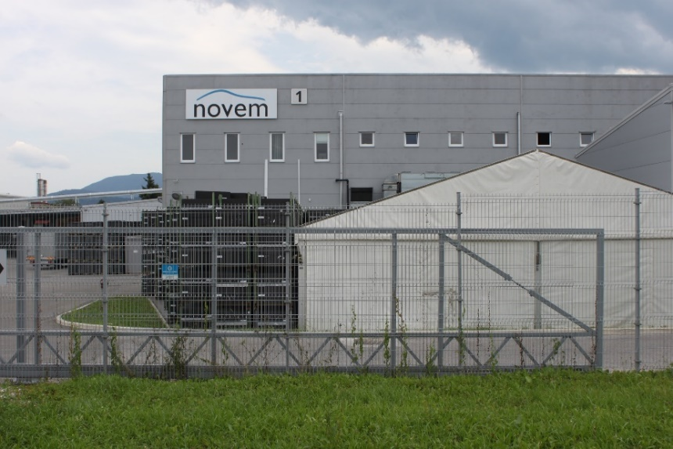
REFERENCES – BUSINESS FACILITIES

Slide 18
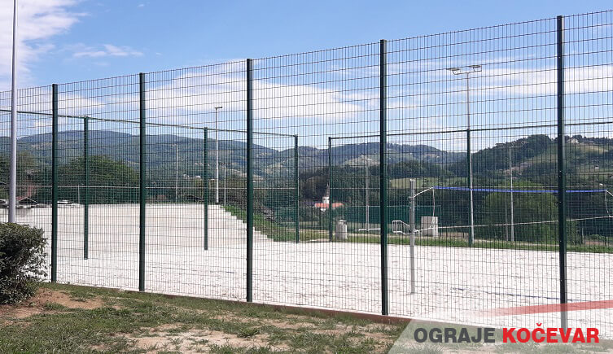
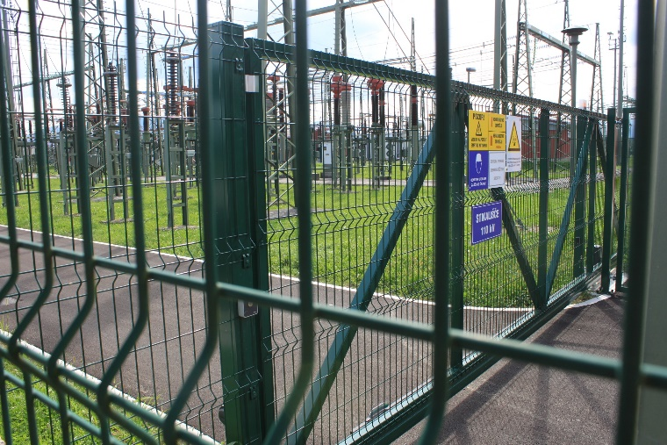
REFERENCES – PUBLIC INFRASTRUCTURE

Slide 19
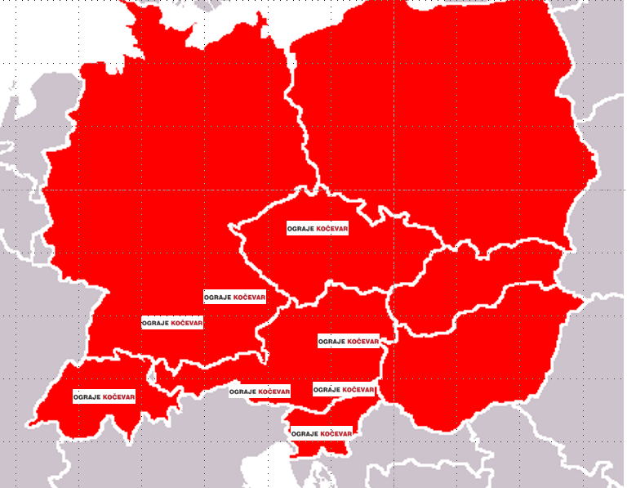
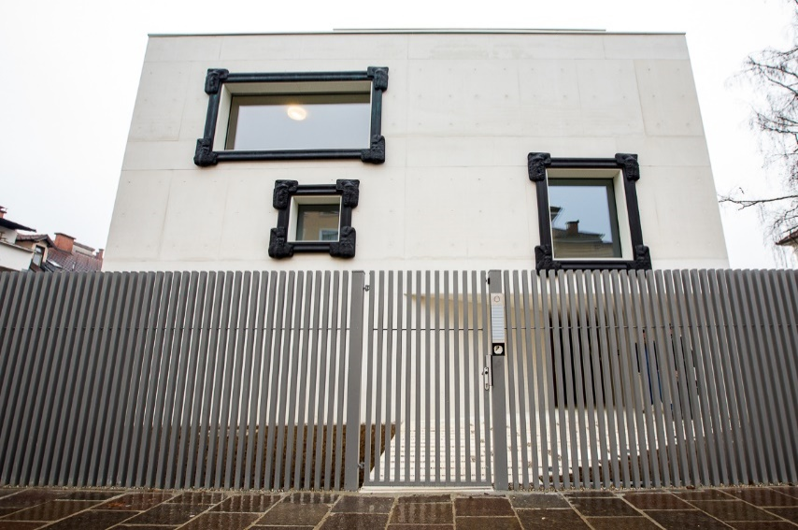
OUR VISION
Complete fencing solutions (with focus on the most demanding customers)
CE market leader in complete fencing solutions
Development of standard products in the direction of modularity
Development of non-standard products in the direction of Individualization, uniqueness.
OGK Group in 2030

Slide 20
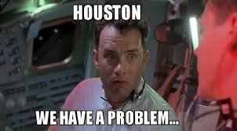
OGK INNOVATIONS & SOLUTIONS
Product innovation
Process Innovation
Continuous improvements
Focused on new, hard-to-reach benefits for customers
Complete Customer Experience Strategy

Slide 21
WE ARE LOOKING FOR PARTNERS IN THE FOLLOWING AREAS:
Producers in the sector of wire fence systems.
Strategic partners in the field of security, perimeter protection.
Manufacturers of individual components of fencing systems.
Strategic partners for brand development in the field of fencing systems in the territory of Western Europe.
Potential financial investors who are interested to enter the EU market
Financial investors with an interest in entering the EU market
Financial investors with an interest in investing in the company and overall growth in the EU market

Slide 22
COOPERATION POTENTIALS
Suppliers of steel half-products:
wire,
profiles
steel sheet
Suppliers of aluminium extruded profiles
Components from security and perimeter protection industries
Partners interested in collaborating on special projects

Slide 23
Zdenka Pečnik Kočevar, CEO
OGRAJE KOČEVAR d.o.o.
Tovarniška cesta 11 c, 3312 Prebold Slovenia - EU
zdenka@ograje.com
M: +386 (0)41 754 865
www.ograje.com

Slide 24
Janez Kočevar
OGRAJE KOČEVAR d.o.o.
Tovarniška cesta 11 c,
3312 Prebold
Slovenia
Janez.Kocevar@ograje.com
+386 41 588 022
www.ograje.com

